Slide 1
Password Protected Door Lock System
Jannatul Ferdous Eva (18201053)
Saqib Sizan Khan (18201061)
Ayman Hasib (18201065)

Slide 2
Contents of Presentation
Objective
Introduction
Components
Software Description
Advantages
Disadvantages

Slide 3
Objective
Increase the Security level to prevent an unauthorized unlocking of the door.
Provide extra privacy by using the password protected system.

Slide 4
Introduction
Since the main intention of this project is to design a Security Door Locks System. In order to fulfill this application, there are few steps that have been performed:
Designing the power supply for the entire circuit.
Selection of microcontroller that suits our application.
Use keypad for getting pass code.
Using Servo motor for unlocking.
Using LCD for knowing the door condition.
Complete studies of all the above points are useful to develop this project.

Slide 5
01.
Arduino UNO
04.
Servo Motor
02.
Liquid Crystal Display (LCD)
05.
Wires
03.
Keypad
06.
Ground
Components

Slide 6

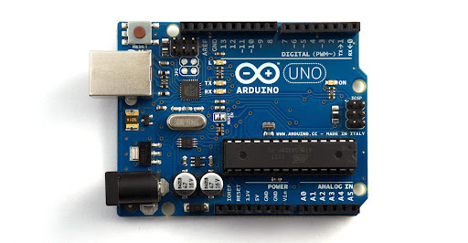

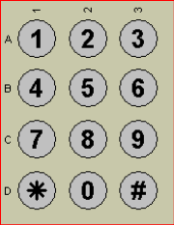
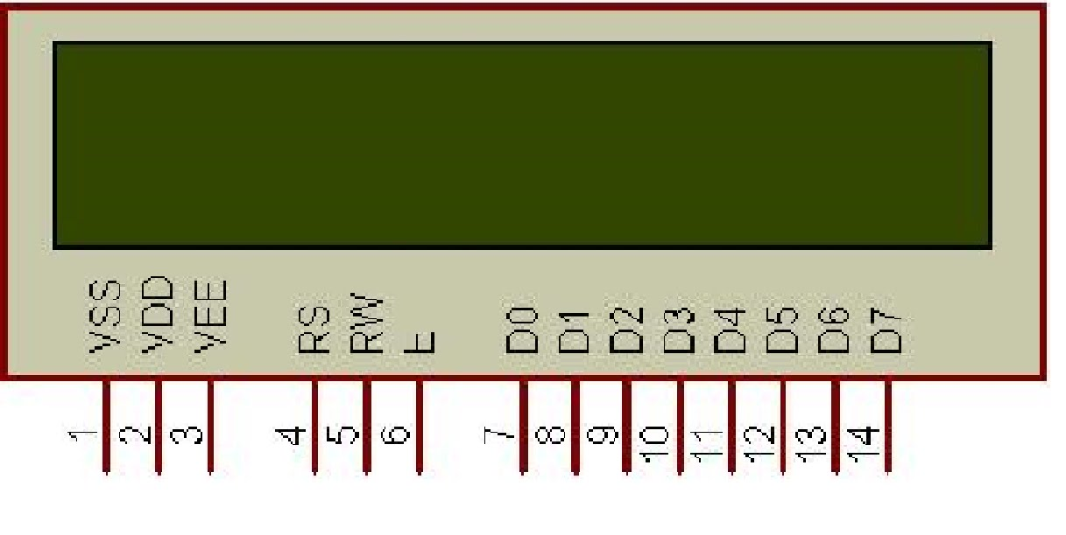
Project Components Images
UNO
Ground
Motor
LCD Display
Keypad

Slide 7
Software Description
Proteus software
Used for simulation of circuit.
Arduino IDE
Used for sketching and associate with proteus.

Slide 8
Advantages
Disadvantages
No keys to be lost, stolen or occupied.
Can be locked using keypad.
Automatic door opening.
Gives an indication for unauthorized entry.
Totally cost efficient.
Currently if the personal identification number is somehow forgotten the system could not be accessed.
Powered by electricity may not function properly in the case of a power failure.

Slide 9
Thank You

